Slide 1

Web Application Testing Final Project

Slide 2


Web application
Online store for Bicycles, cycling items and accessories
It is also a physical store with a warehouse & service

Slide 3
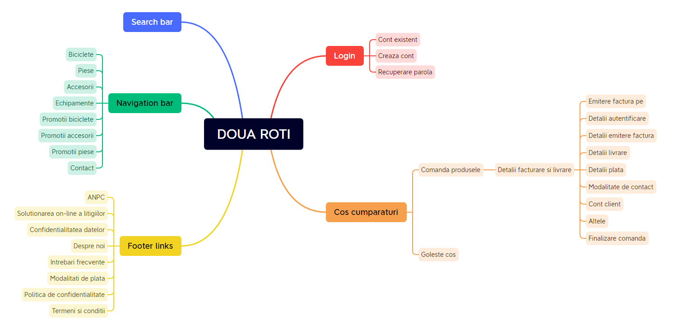
APP STRUCTURE

Slide 4

TESTING APPROACH
Ad-hoc testing to check if the application can be further tested
Logged Smoke tests and executed them for main functionalities
Negative testing
Positive testing
Compatibility testing
Exploratory testing to focus more on the main functionalities and UI&UX testing

Slide 5


TOOLS THAT WERE USED
Mantis Bug Tracker -> Bug Reporting
Excel -> Test Case Management & Test Report
Word Counter -> Character counter
Lipsum generator -> Text Generation
Xmind -> Mind Maps
Snipping Tool -> Screenshots

Slide 6
TESTING TYPES
PERFORMED | RECOMMENDED
Smoke testing | Code review
Negative testing | Security testing
Positive testing
System testing
Compatibility testing
Exploratory testing

Slide 7
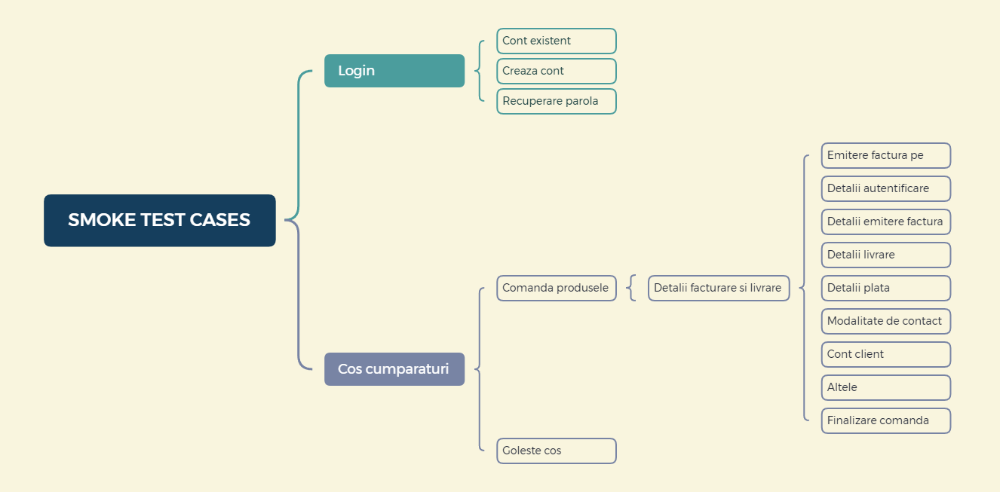
TEST CASES OVERVIEW
TOTAL: 40 TEST CASES

Slide 8
TEST CASES RESULTS
Functionality | Total | Passed | Failed | Blocked | Not run | Defects
Creaza cont | 14 | 8 | 6 | 0 | 0 | 52837, 52838, 52839, 52841, 52842
Cont existent | 5 | 5 | 0 | 0 | 0
Recuperare parola | 2 | 0 | 2 | 0 | 0 | 52843, 52844
Account activation | 3 | 2 | 1 | 0 | 0 | 52845
Comanda produsele | 6 | 1 | 5 | 0 | 0 | 52846, 52847, 52849, 52864, 52865
Goleste cos | 4 | 2 | 2 | 0 | 0 | 52851, 52866
Browser compatibility | 3 | 3 | 0 | 0 | 0
Device compatibility | 3 | 1 | 2 | 0 | 0 | 52867, 52868
Overall results | 40 | 22 | 18 | 0 | 0 | 17

Slide 9

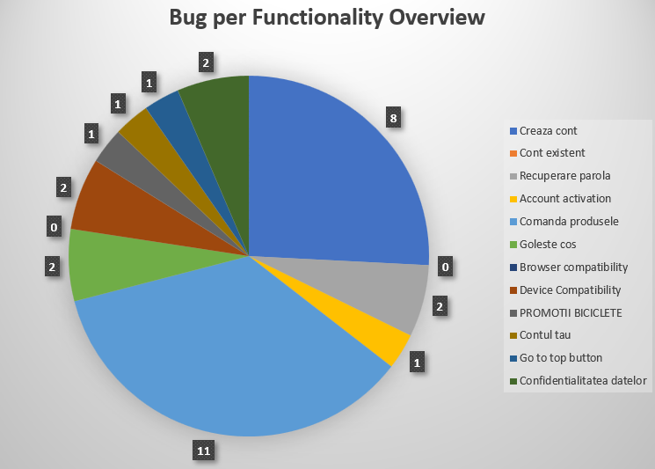
BUGS OVERVIEW

Slide 10
CONCLUSIONS
40 test cases were run to test the happy and negative flows
28 bugs were identified: 4 minor, 24 normal
2 improvements found: 1 major and 1 normal
Most of the bugs were identified through Negative Testing as well as by performing Exploratory Testing
Types of data that were used: Valid, Invalid, Big Data and Blank
Fixing at least the most problematic area – “Cos cumparaturi” – is recommended

Slide 11



LESSONS LEARNED
Challenges
Lessons
Finding an app that had enough bugs to showcase a testing strategy
Test design while also dealing with time constraint
Keeping track of test cases and bugs in manual tool like Excel
Testing without requirements
Ad-hoc testing is inevitable
Exploratory testing reveals most of the flows the end user will go through
Following the STLC phases is crucial for accurate results
Using tracking and management tools saves time

Slide 12
T HANK YOU!
Your feedback is appreciated!

